Slide 1
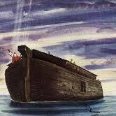
Noah’s Ark Was it feasible?
Slides will advance automatically. Enjoy the presentation!

Slide 2
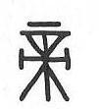
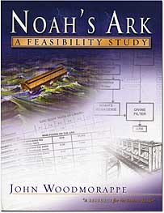
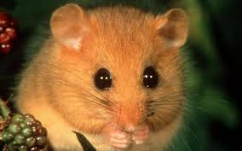
Ancient Chinese writing
A Polish immigrant who suffers from Tourettes
Dormice

Slide 3
Oracle bone
writing
over 4000 years old
150,000 specimens
pictograph script

Slide 4
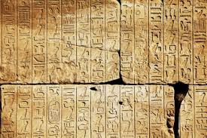
‘Hieroglyphics’
‘hiero’ = sacred
‘glyph’ = writing or engraving
Hebrew pictograph

Slide 5
ShangDi
‘God Above’ or
‘Most High God’
Compare to Shaddai

Slide 6
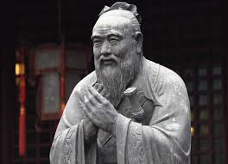
‘The Border Sacrifice’
‘The ceremonies of the celestial and terrestrial sacrifices are those by which men serve ShangDi’.
Confucius 551- 479 BC
‘

Slide 7
Quote from the Ming Dynasty
‘Of old in the beginning, there was great chaos, without form and dark. The planets had not begun to revolve, or the sun and moon to shine. You, O Spiritual Sovereign first divided the grosser parts from the purer. You made heaven. You made earth. You made man. All things with their reproducing power got their being’.
1300-1600 AD

Slide 8
Ancient Chinese description of Dao
The Dao exists as one.
One exists as two.
Two exist as three, and
Three create everything.
‘For there are three who bear witness in heaven: the Father, the Word, and the Holy Sprit: and these three are one’. 1 John 5:7

Slide 9
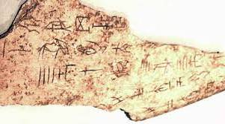
Oracle bones and shells

Slide 10
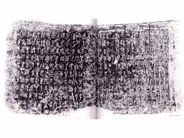
Bronze-ware pictograph

Slide 11
Old Testament theology
God rests on 7th day
Adam and Eve
Garden of Eden
Talking serpent
Fall of man
Angels with flames to guard Eden

Slide 12
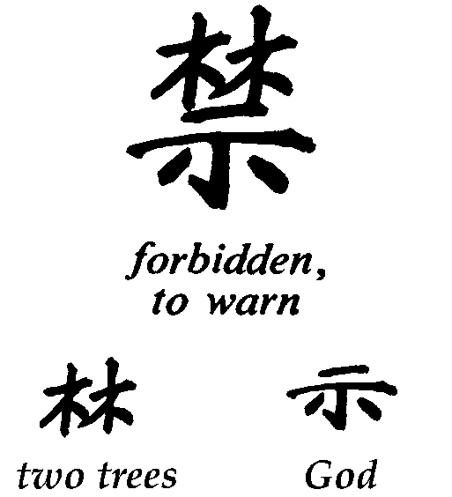
‘Forbidden’

Slide 13
‘Covet’

Slide 14
‘Devil’
Devil | = Secret | + Person | + Garden

Slide 15
‘Stumble or fall’

Slide 16
‘Alone’
Two people outside a garden

Slide 17
‘Naked’
Naked | = Clothing | + Tree | + Garden

Slide 18
‘Violent, fierce, aggression’

Slide 19
‘Righteousness’
Sword Hand (Me) Small sheep

Slide 20
‘Snake’
New Testament theology
God had a rescue plan
Would arrive as a Saviour
(through a woman’s seed)
Would shed blood for mankind
Would crush a snake

Slide 21
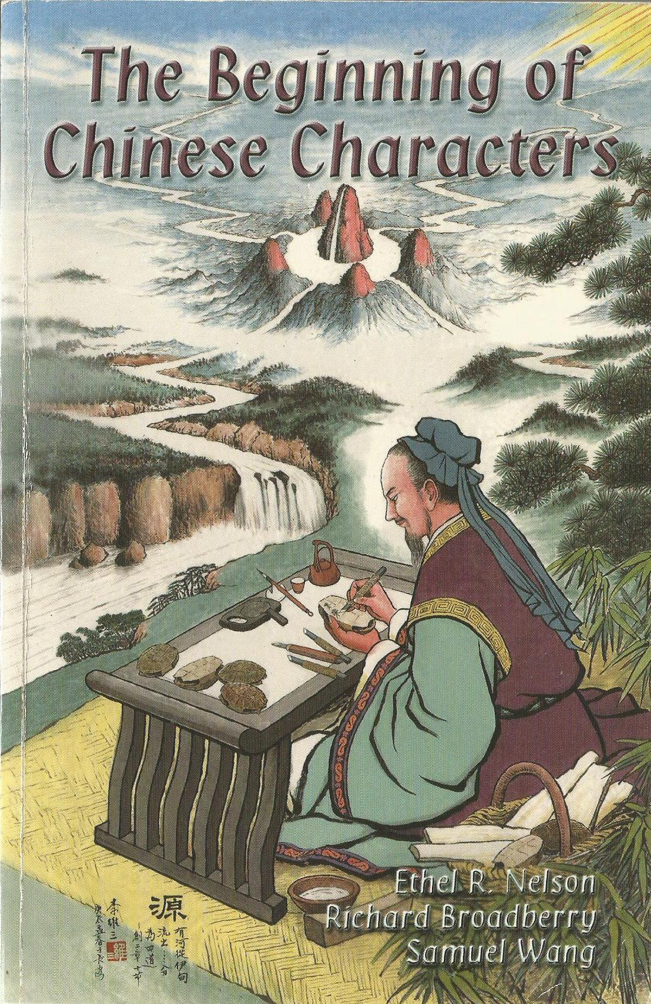

Slide 22
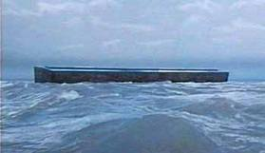
Legends about a universal flood
North American Indians 46
Far East and Indonesia >30
World wide >1000

Slide 23
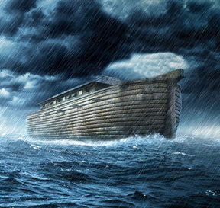
Agreement on 3 features
A universal catastrophe destroyed the human race and all other living things, with water.
A boat provided the only means of escape.
A seed of mankind was preserved to perpetuate the human race.

Slide 24
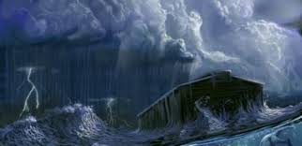
Most agree a 4th feature
Man’s wickedness is the cause
of the flood.

Slide 25
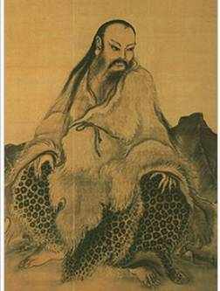
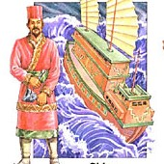
Chinese legendary hero
‘Nu-wa’ (Mainland China)
‘Nu-u’ (Islands)
‘The righteous man’
‘Nu kua’ (Oracle bones)

Slide 26
‘In the beginning’
floodwater

Slide 27
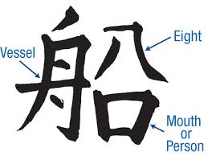
‘Boat/ship’

Slide 29
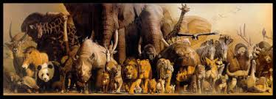
Three Questions
How many animals were on the Ark? (and what sort)
What about their food + water requirements?
What on earth did 8 people do with all that waste material?

Slide 30
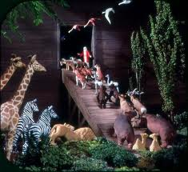
How many animals?
Two of every kind of bird, of every kind of animal and every kind of creature that moves along the ground will come to you to be kept alive’
Genesis 6:19

Slide 31
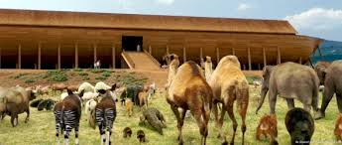
How many animals 1. ?
‘Pairs of clean and unclean animals, birds and all creatures that move along the ground – male and female – came to Noah and entered the Ark’. Genesis 7:8
‘Pairs of all creatures that have breath of life in them came to Noah and entered the Ark’ . Genesis 7:15

Slide 32
How many animals 2 ?
‘Take with you seven of every kind of clean animal, a male and its mate, and also seven of every kind of bird, male and female to keep their various kinds alive throughout the earth’. Genesis 7:2.
ie‘Take seven seven, a male with his female’

Slide 33
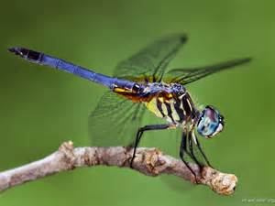
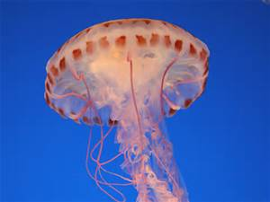
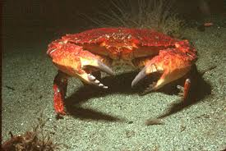
Hebrew terminology rules out all invertebrates – example:
What sort of animals went on board?
insects jellyfish crabs

Slide 34
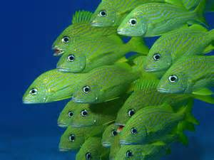
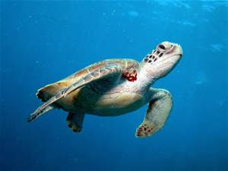
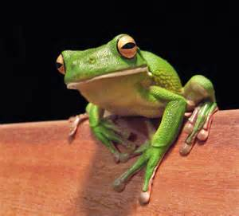
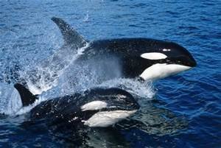
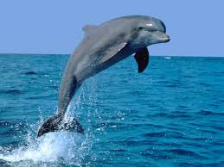
All marine and amphibious vertebrates - such as fish, frogs, turtles, whales, dolphins etc.

Slide 35
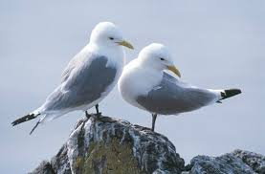
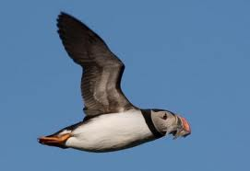
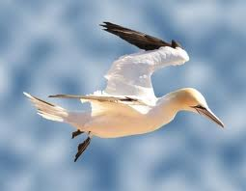
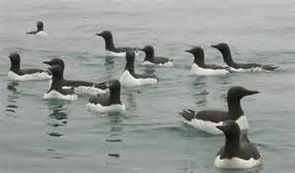
Most seabirds

Slide 36
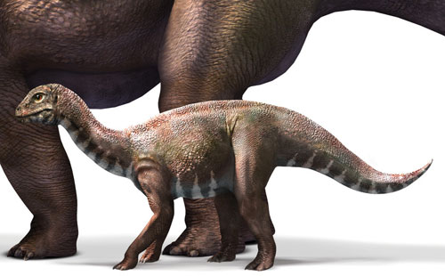

Slide 37
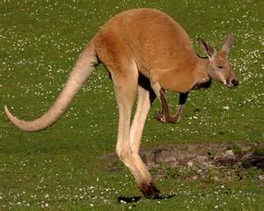
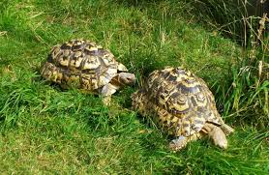
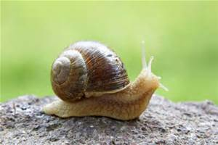
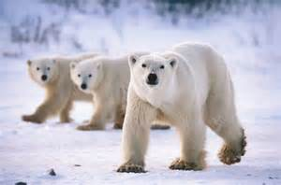
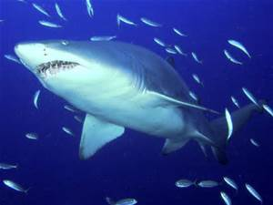
Criticisms

Slide 38
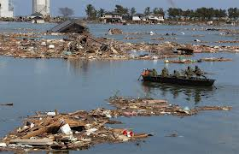
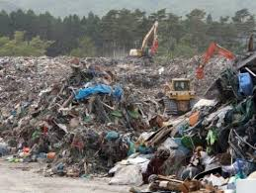
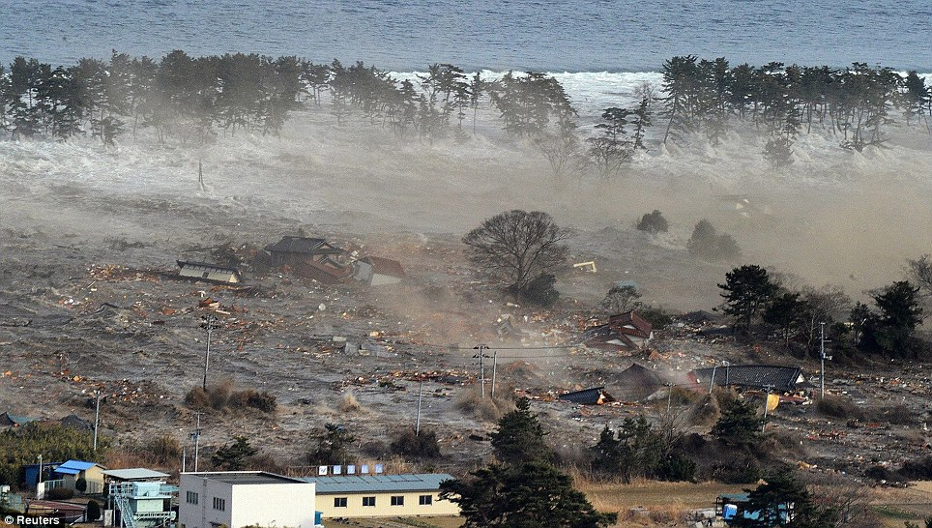
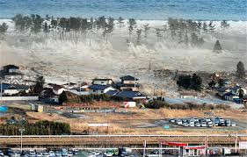
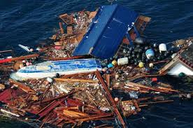
Rafts of floating Tsunami vegetation + debris

Slide 39
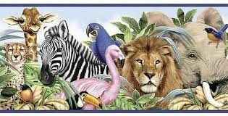
So how many animals in total went on board the Ark?

Slide 40
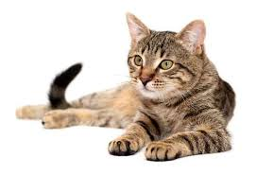
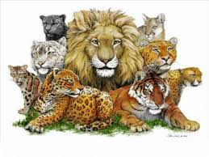
Kind or species?
Kingdom Animalia
Phylum Chordata
Class Mammalia
Order Carnivora
Family Felidae
Genus Felis
Species catus
< Kind
< Species

Slide 41
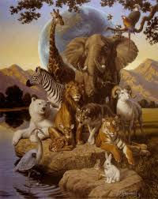
Woodmorappe uses:-
‘Genus’ rather than ‘Family’
seven pairs of clean animals
fossils + extinct creatures
circa 16000 animals
comprising
7428 mammal
4602 birds
3724 reptiles

Slide 42
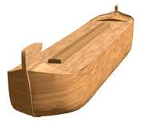
Was the ark big enough?
For 16,000 animals
plus all their
enclosures
food + water
waste products
…………..and a human family of 8?

Slide 43
Ark dimensions
Cubit = 18”
300 cubits
50 cubits
30 cubits

Slide 44
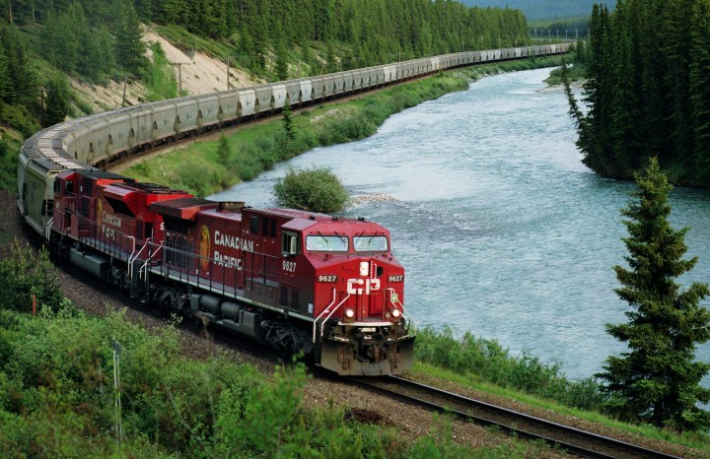
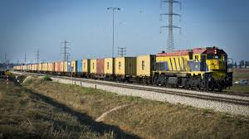
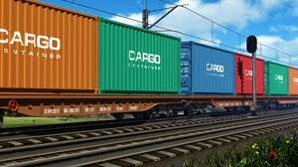
John Whitcomb
Internal capacity
522 box cars
or
1000 ship
containers

Slide 45
Frederic Filbey:; The Flood Reconsidered

Slide 46
First ship built larger than Ark
Brunel’s ‘Great Eastern’
‘SS Great Britain’
Frederic Filbey ‘The Flood Reconsidered’

Slide 47
Data from zoos + farms
Body weight + volume from humming-birds to dinosaurs
Three decks + enclosures for all
Average size of 90% livestock = a sheep
16000 animals occupy just 50% of total space available

Slide 48
Food and Water?
Take ‘every kind of food on board and store it away’. Genesis 6:21
Amount + volume of food/water for 371 days.
Dry weight - hay, grain, fruit, dried meat + fish
2500 tons = 10% of total ark space

Slide 49
Specialist feeders 1

Slide 50
Specialist feeders 2

Slide 51
Carnivores
Omnivores

Slide 52
Vegetarians
90%

Slide 53
Grains, fruit + juice storage

Slide 54
Vermi-composting
1% of space

Slide 55
Fresh water

Slide 56
How much water needed?
4 million litres
9.4 % of total ark volume

Slide 57
Ancient water containers

Slide 58
Ark Capacity summary

Slide 59
The biggest objection - Poo!
What about all that manure?
How did just 8 people cope?
What about smells, explosive gases, and vermin?
Total faeces, urine + soiled bedding per day
= 12 tons

Slide 60
Self cleaning enclosures

Slide 61
Hazardous noxious gases
from 84 tons of manure a week
Air ventilation systems on ancient ships

Slide 62
19:00 21 April 2005
‘Stink bomb gas puts mice into suspended animation’
‘Suspended animation has been deliberately induced in a species of mouse. The first time such a feat has been achieved, say the procedure's pioneers. If a similar response could be triggered in humans, there would be major healthcare benefits, and suspended animation on long-haul space flights would move a step closer. The mice were induced to fall into their deep sleep after being exposed to hydrogen sulphide.’

Slide 63
Children’s story or True?

Slide 66
Matthew 24:31
‘The arrival of the son of man will take place in times like Noah’s. Before the great flood, everyone was carrying on as usual, having a good time, right up to the day Noah entered the ark. They knew nothing until the flood hit them, and swept everyone away’

Slide 68
Presentation:- David Wright

